Slide 1

Voice Enabled Smart Braille Assistive System

Slide 2
Voice Enabled Smart Braille Assistive System
Presented by: A.Naganjali (22491A056A)
V.Amani (22491A055K)
V.kesava Rao (22491A055I)
B.Aravind (22491A056D)
Ch.Hari Krishna (22491A056I)
Ch.Gopaiah (22491A056K)
Under the Guidance of:
Dr.Kakumanu Naga Raju
Assistant professor
Department of CSE

Slide 3
Outline
Abstract
Introduction
Literature Review
Motivation
Objective
Existing Method
Proposed Method
Block Diagram
Hardware & Software
Applications & Advantages
System Architecture/Proposed work Block diagram
UML Diagrams (CSE & Allied)/DFD CSE & Allied / Prototype (others)
Implementation(part Of The Code)
Testing/Simulation
Results And Discussions
Conclusions And Future Scope
References

Slide 4
Abstract
Visually impaired people mainly depend on Braille for reading and understanding information
Most information today is available in spoken form such as lectures, announcements, and voice instructions
Converting spoken information directly into Braille is difficult using existing systems
The proposed system converts speech into tactile Braille output
Speech-to-text conversion is used to process the user’s voice
A simple Braille display mechanism is used to represent characters
The system is low-cost and easy to use
It helps visually impaired users access spoken information independently

Slide 5
Introduction
Assistive technology plays an important role in helping people with disabilities lead more independent lives. For visually impaired individuals, Braille is the most widely used method for reading and understanding written information through touch. However, in recent years, most information has become voice-based, such as classroom teaching, announcements, and digital voice assistants. Visually impaired users often face difficulty in accessing this spoken information in Braille form. Existing Braille systems mainly focus on text input and are either costly or complex to use. Therefore, there is a need for a simple and affordable system that can convert spoken words directly into Braille. This project aims to address this need by developing a voice-enabled smart Braille assistive system.

Slide 6
Literature survey
Ref. No | Title & Authors (Year) | Technique / Contribution | Pros | Cons | PDF / Link
1 | Advancements in Refreshable Braille Display Technology: A Comprehensive Survey — Etezad, Joshi, Cibrian (2025) | Comprehensive review of six types of refreshable Braille display technologies and trends. | Covers real RBD research; open access; authoritative survey. | Focus is breadth not a single solution. | PDF Digital Commons
2 | Refreshable Braille Displays — B. Bhanushali et al. (2018) | Design and implementation of a refreshable Braille display module using hardware actuation. | Practical implementation; early research. | Limited detail; basic prototype paper. | PDF PhDFocus
3 | Refreshing Refreshable Braille Displays — A. Russomanno et al. (2015) | Study on existing refreshable Braille display technologies and haptics challenges. | Peer-reviewed IEEE Transactions article; deep technical insights. | Older research relative to modern materials. | PDF ResearchGate

Slide 7
Ref. No | Title & Authors (Year) | Technique / Contribution | Pros | Cons | PDF / Link
4 | Development and Evaluation of Refreshable Braille Display and Active Touch-Reading System — (2024) | Optimized refreshable Braille display combined with a touch-reading system for digital reading. | Focus on improved force & tactile feel. | Technical focus; less on speech integration. | PubMed
5 | Braille Display Systems for Blind People with Haptic Belt — Kamarudin et al. (2021) | Braille display system using soft actuators and microcontrollers; wearable concept. | Novel interface and wearable form factor. | Specific hardware; not mainstream. | PDF (journal link). IJHATI
6 | Smart Tactile to Audio Braille Converter with Attention Mechanism Model — Akash B S et al. (2025) | OCR to tactile Braille conversion with GPS & extra assistive features. | Innovative multi-feature assistive device. | Not focused solely on speech→Braille; project-style paper. | Journal page w/ DOI. Peer-reviewed Journal
7 | Braille to Text Conversion Using Computer Vision — Purva Kamath et al. (2022) | Braille image segmentation & processing for conversion via image processing. | Braille-vision integration; real PDF. | Focus is Braille→text perception (not speech). | PDF PICES Journal

Slide 8
Ref. No | Title & Authors (Year) | Technique / Contribution | Pros | Cons | PDF / Link
8 | An accessible web-based system for audio transcription and Braille conversion — (2025) | Modular speech recognition & Braille conversion web platform with high accuracy. | Integrates ASR + Braille conversion; real research. | Focus on web integration vs hardware . | Journal site with DOI. Rehabilitation Journals
9 | International Journal of Advances in Engineering and Management – Text-to-Braille Technologies Review — (2024) | Survey of text-to-Braille conversion & audio output in assistive systems. | Broad overview and context for speech/Braille work. | Focus is general text→Braille. | Journal PDF IJAEM
10 | Design and Implementation of Digital Braille System for the Visually Impaired — Shalini et al. (2020) | Hardware implementation of digital Braille conversion system. | Practical implementation; real PDF. | May not include speech input directly. | Pdf Seventh Sense Research Group®

Slide 9
Motivation
Commercial Braille devices are very expensive
Many visually impaired people cannot afford them
Existing solutions are not user-friendly
This motivated us to design a low-cost assistive system

Slide 10
Objective
To convert spoken words into Braille characters
To design a simple and affordable assistive system
To help visually impaired users access spoken information

Slide 11
Existing Method
Existing systems convert text into Braille
User must type the text manually
Real-time speech conversion is not supported

Slide 12
Proposed Method
User speaks through a microphone
Speech is converted into text using Python
Text is converted into Braille patterns
Braille output is produced using solenoids

Slide 13
PROPOSED WORK: SPEECH MODULE
Microphone captures the user’s voice
Speech-to-text module converts voice into text
Converted text is sent to the controller

Slide 14
PROPOSED WORK: CONTROLLER UNIT
Controller receives Braille code
Controls solenoids based on Braille pattern
Ensures correct dot representation

Slide 15
PROPOSED WORK: BRAILLE OUTPUT UNIT
Six solenoids represent six Braille dots
Raised solenoid indicates a dot
Characters are displayed one by one

Slide 16
Block Diagram
Microphone
↓
Speech-to-Text Module
↓
Braille Converter
↓
ESP32 / Arduino
↓
Braille Output Unit

Slide 17
Hardware Used
ESP32 / Arduino
Microphone module
Solenoids / vibration motors
Driver circuit
Power supply

Slide 18
Software Used
Python (Speech Recognition)
Arduino IDE
Serial / Bluetooth communication

Slide 19
Applications
Schools for visually impaired students
Assistive reading devices
Public information systems

Slide 20
Advantages
Low cost
Simple design
Easy to use
Socially beneficial

Slide 21
System Architecture/Proposed work Block diagram
System Architecture
Our system is designed to convert spoken words into Braille
It mainly helps visually impaired people understand voice-based information
The system uses a combination of software and hardware
Voice input is processed and shown as Braille dots

Slide 22
PROPOSED WORK BLOCK DIAGRAM
Block Diagram of the System
User Voice
↓
Microphone
↓
Speech-to-Text Module
↓
Text to Braille Converter
↓
ESP32 / Arduino
↓
Driver Circuit
↓
Braille Output Unit

Slide 23
BLOCK DIAGRAM WORKING
How the System Works
First, the user speaks near the microphone
The microphone listens and captures the voice
The system converts the voice into text
That text is changed into Braille format
The controller controls the solenoids
Finally, Braille dots are displayed

Slide 24
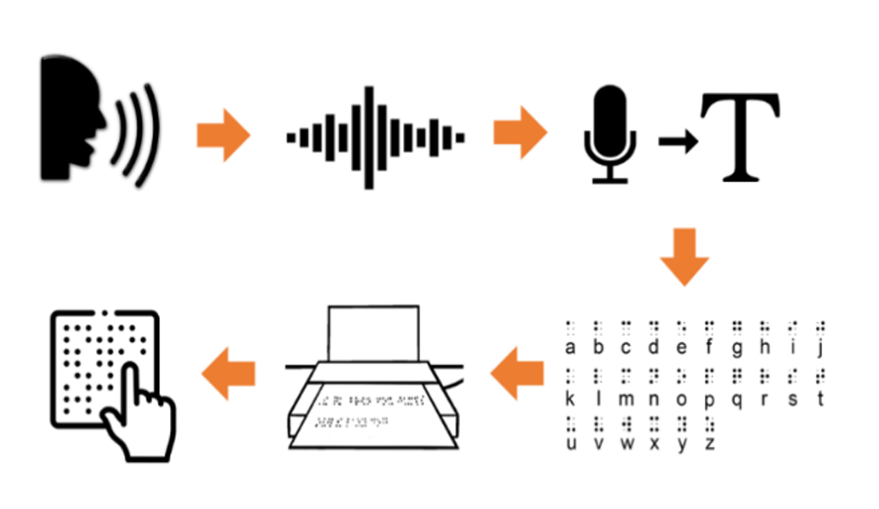
UML DIAGRAMS (CSE & ALLIED)

Slide 25
UML Diagrams Overview
UML diagrams help us understand how the system works
They show interaction between user and system
Mainly used in computer science related branches

Slide 26
DFD (DATA FLOW DIAGRAM)
DFD Overview
DFD shows how data moves inside the system
Voice data is processed step by step
Used to explain system flow clearly

Slide 27
DFD Level 0 & Level 1
Level 0 DFD (Context Diagram)
User gives voice input
System processes the input
User receives Braille output
Level 1 DFD (Humanized)
Voice is converted into text
Text is converted into Braille
Braille data is sent to the controller
Output is shown using Braille dots

Slide 28
PROTOTYPE (OTHERS)
Prototype Overview
Prototype is a working model of our system
It shows how voice can be converted into Braille
It works in real time
Components Used
Microphone
ESP32 / Arduino
Solenoids
Driver circuit
Power supply

Slide 29
PROTOTYPE WORKING
User speaks near the microphone
System listens and understands the voice
Voice is converted into Braille
Braille dots are raised using solenoids
User reads output by touch

Slide 30
Implementation (Part of the Code)
Speech Recognition Module
import speech_recognition as sr
r = sr.Recognizer()
with sr.Microphone() as source:
print("Speak now...")
audio = r.listen(source)
text = r.recognize_google(audio)
print(text)

Slide 31
Braille Conversion Logic
braille_dict = { 'a':'⠁','b':'⠃','c':'⠉','d':'⠙','e':'⠑', 'f':'⠋','g':'⠛','h':'⠓','i':'⠊','j':'⠚' } def text_to_braille(text): return ''.join(braille_dict.get(ch,' ') for ch in text)
Modules Used
i) Speech Recognition Module ii) Text Processing Module iii) Braille Conversion Logic iv) Output Display (Software/Hardware)
Working Flow
Speech Input → Text Conversion → Braille Translation → Output Display

Slide 32
Working Flow
Speech Input → Text Conversion → Braille Translation → Output Display
Working:
The implementation phase focuses on converting spoken words into Braille output using software and hardware components.
First, the system captures the user’s voice through a microphone using a speech recognition module. The spoken words are converted into text using Google’s speech recognition engine.
Next, the converted text is processed using a Braille conversion algorithm. Each character in the text is matched with its corresponding Braille pattern stored in a dictionary.
Finally, the Braille output is displayed either:
on the screen as Braille symbols, or
through Arduino-controlled pins that activate Braille dots.
This step-by-step processing enables real-time voice-to-Braille conversion, making the system helpful for visually impaired users.

Slide 33
Testing / Simulation
Testing Methods
i) Voice input tested with multiple words ii) Tested in noisy and quiet environments iii) Verified Braille output accuracy iv) Simulated Braille output on screen
Voice Input | Text Output | Braille Output
Hello | hello | ⠓⠑⠇⠇⠕
Good | good | ⠛⠕⠕⠙

Slide 34
Results And Discussions
Results
i) Speech successfully converted to text ii) Text accurately converted to Braille iii) System works in real-time iv) Output readable for visually impaired users
Discussion
Accuracy depends on voice clarity
Noise may slightly affect recognition
Processing speed is fast and efficient
Low-cost solution compared to commercial devices

Slide 35
Conclusions And Future Scope
Conclusion
Developed a real-time voice-to-Braille system
Helps visually impaired users access information
Affordable and easy to use
Demonstrates assistive technology innovation
Future Scope
i) Add multi-language support ii) Improve noise filtering accuracy iii) Integrate mobile app connectivity iv) Develop portable wearable device v) Add rechargeable battery support

Slide 36
References
1. M. Etezad, R. Joshi, and F. L. Cibrian, “Advancements in Refreshable Braille Display Technology: A Comprehensive Survey,” Displays, vol. 90, 2025. Chapman University Digital Commons 2. B. Bhanushali, A. Dhoot, P. Gandhi, and K. Mehta, “Refreshable Braille Displays,” Int. J. Computer Applications, vol. 180, no. 37, 2018. IJCA 3. “Visual and Tactile Perception Techniques for Braille Recognition,” Micro and Nano Systems Letters, 2023. SpringerLink 4. S. Alzalabny, O. Moured, K. Müller, et al., “Design and Evaluation of a Multisensory Tangible Game Device for Inclusive Pre‑Braille Literacy,” Education Sciences, 2025. MDPI 5. “Development and Evaluation of Refreshable Braille Display and Active Touch‑Reading System for Digital Reading,” PubMed, 2024. PubMed

Slide 37
References
6. M. N. Kamarudin et al., “Braille Display Systems for Blind People with Haptic Belt,” Int. J. Human and Technology Interaction, vol. 5, 2021. IJHATI
7. R. Suzuki et al., “FluxMarker: Enhancing Tactile Graphics with Dynamic Tactile Markers,” arXiv, 2017. arXiv
8. T. Bhatnagar et al., “Pixelated Interactions: Exploring Pixel Art for Graphical Primitives on a Tactile Display,” arXiv, 2023. arXiv
9. “A Survey on Tactile Displays for Visually Impaired People,” PubMed. PubMed
10. S. O’Modhrain et al., “Designing Media for Visually‑Impaired Users of Refreshable Touch Displays: Possibilities and Pitfalls,” IEEE Trans. on Haptics, 2015. Experts at U of M

Slide 38
Thank you

